Slide 1
South Florida Property Listings
Featuring 10 properties for sale with images and details

Slide 2
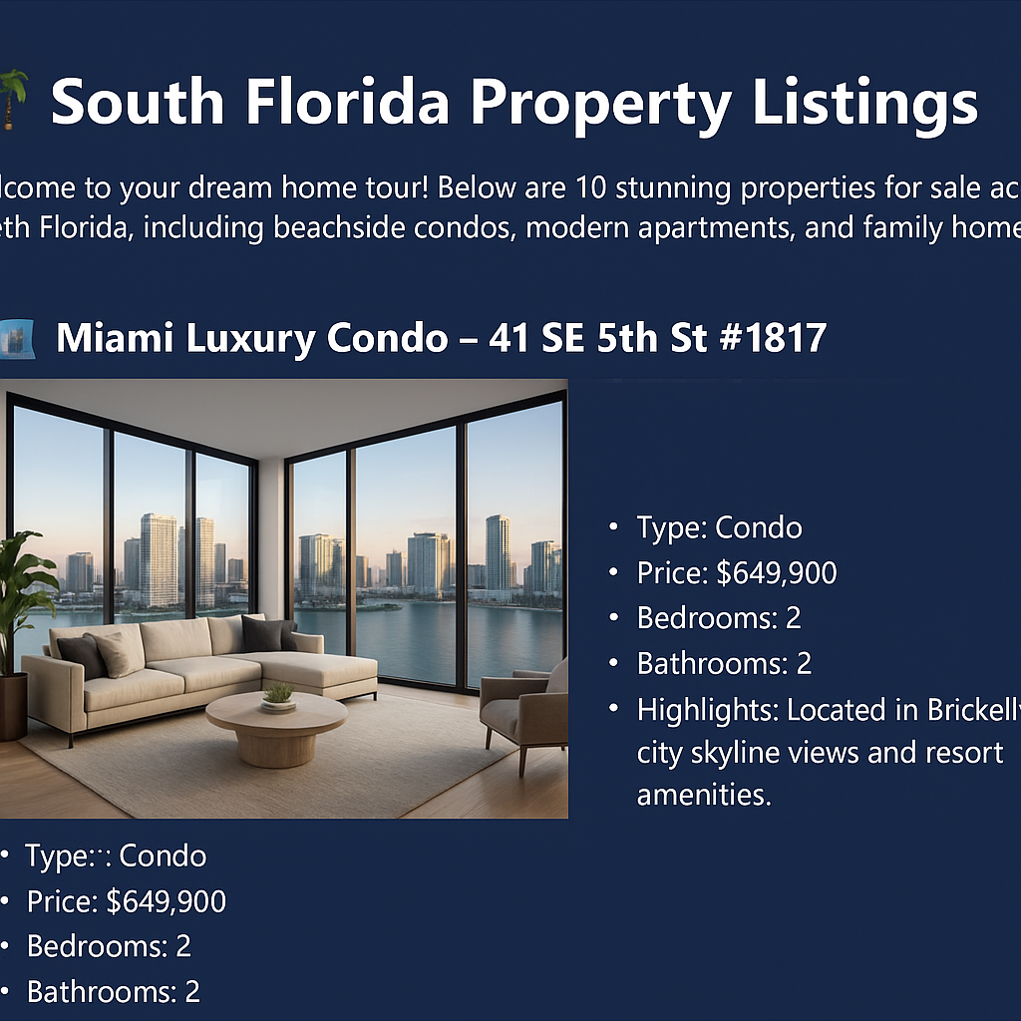
Miami Luxury Condo
📍 41 SE 5th St #1817, Miami, FL
💲 $649,900
🛏 2 BD 🛁 2 BA
✨ City skyline views, resort amenities

Slide 3
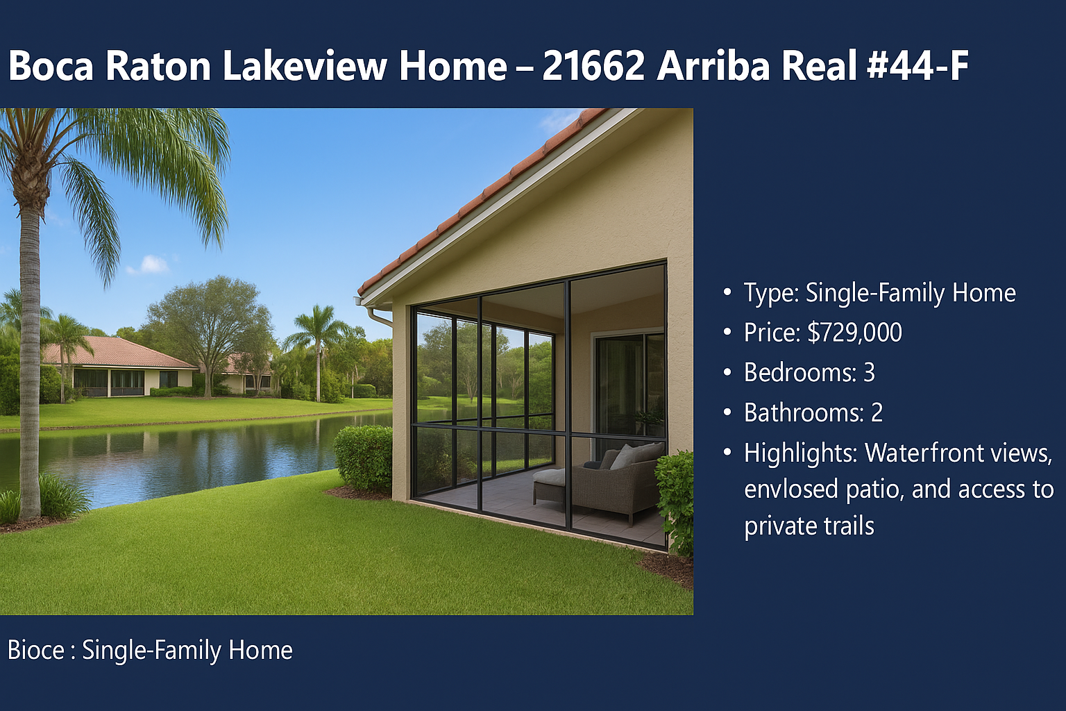
Boca Raton Lakeview Home
📍 21662 Arriba Real #44-F, Boca Raton, FL
💲 $729,000
🛏 3 BD 🛁 2 BA
✨ Waterfront views, enclosed patio

Slide 4
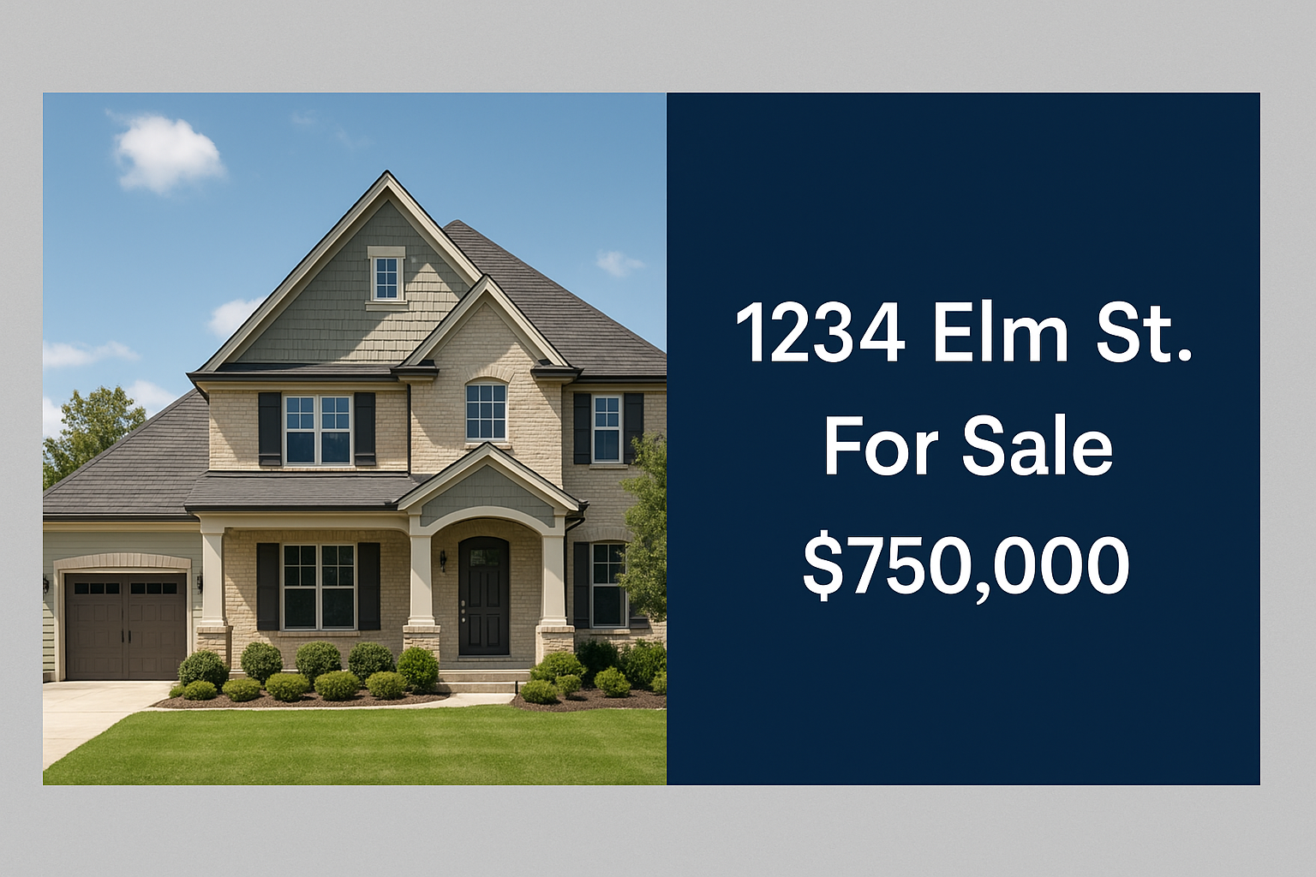
Elm Street Traditional Home
📍 1234 Elm St, Fort Lauderdale, FL
💲 $750,000
🛏 4 BD 🛁 3 BA
✨ Charming exterior, spacious lot

